Slide 1
ShipRealWind Calculator 3.0
Elena-Grațiela ROBE-VOINEA

Slide 2
Cuprins
Arhitectura
Tipuri de testare
User story (US)
Test case (TC) și Test Run (TR)
Bug/Defect
Concluzii- Matrix

Slide 3
Arhitectura
VAISALA naval Weather Transmitter WXT530 Series for speed ​​and wind
Input from the code:
Ship's heading
Ship's speed
ShipRealWindCalculator 3.0
(Python based sofware)
Windows
Output:
Real wind heading
Real wind speed
Plot
Plotting data
Raspberry Pi 3 model B + MicroSD Card Noobs Raspberry Pi V3 16 GB
Input form the wheater station in real time
Wind's apparent speed
Wind's apparent heading

Slide 4
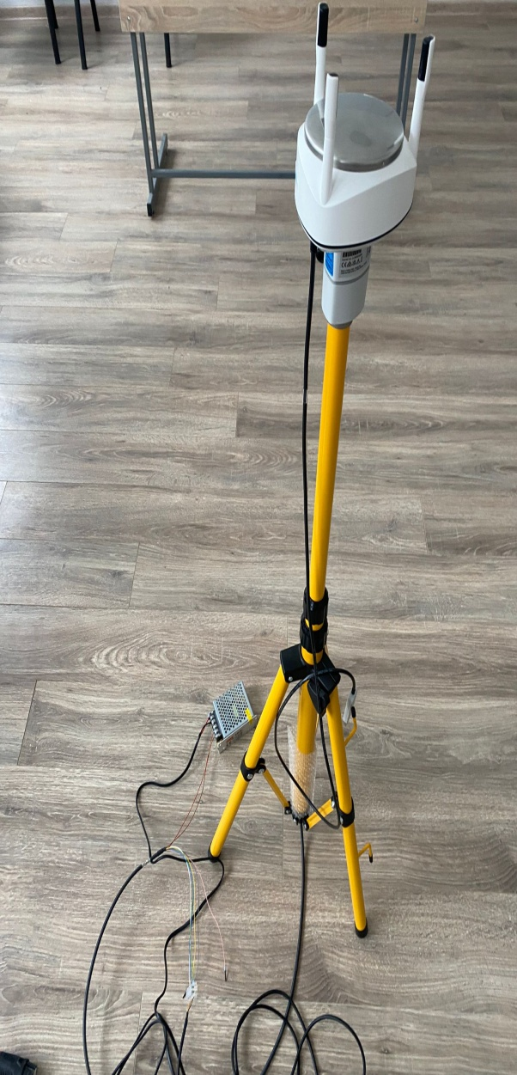
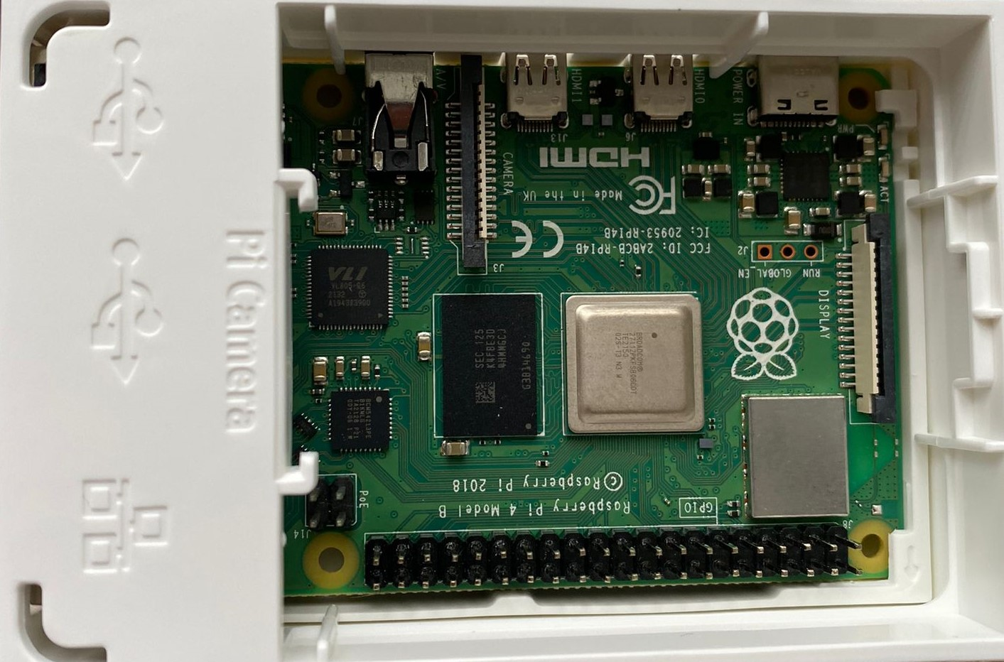
Arhitectura

Slide 5
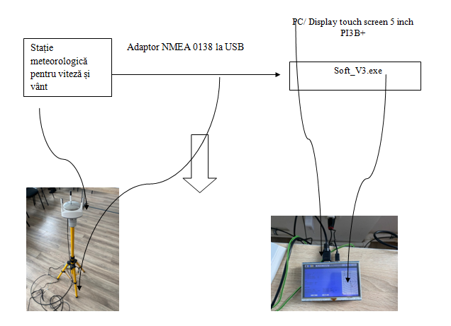
Arhitectura

Slide 6
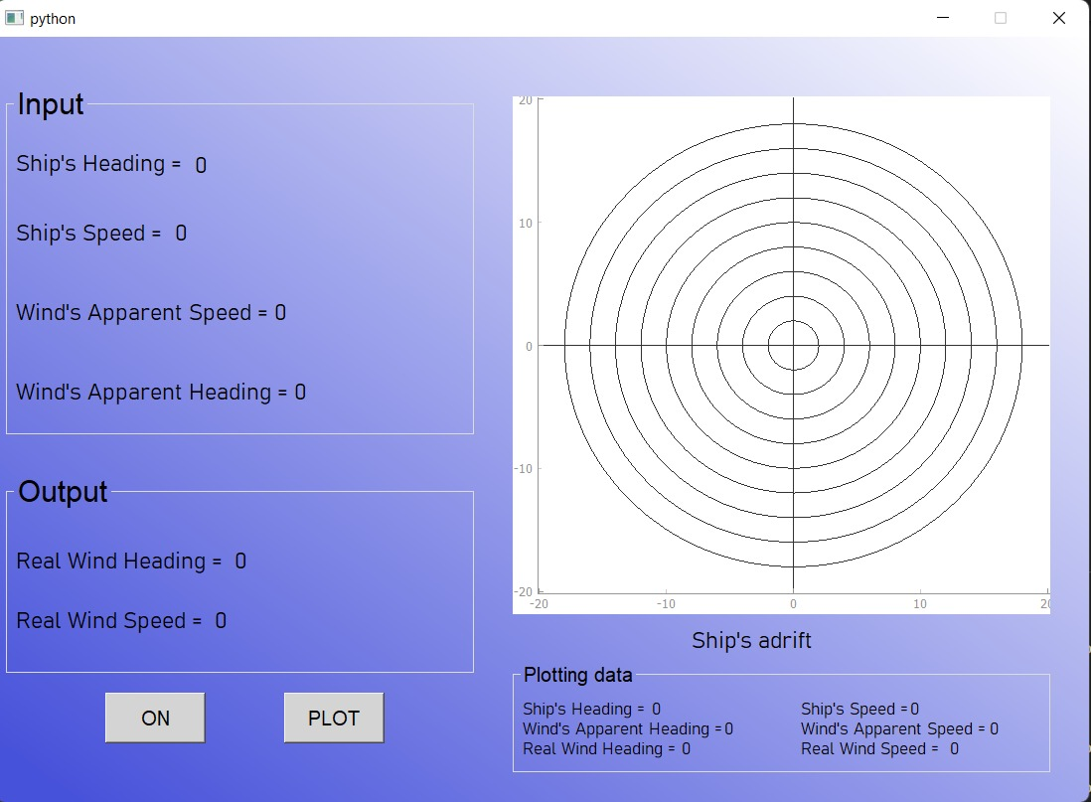
ShipRealWind Calculator 3.0 Main window-before execution

Slide 7
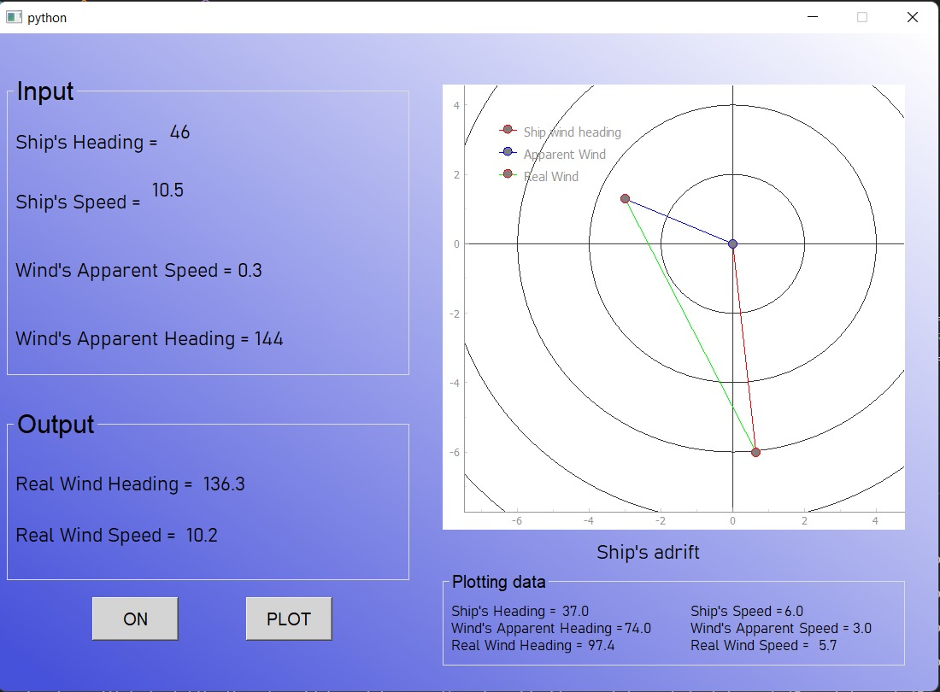
ShipRealWind Calculator 3.0 Main window-after execution

Slide 8
Tipuri de testare aplicate
Manual
Non-Functional
Functional
Acceptance testing
System testing
-Black-Box testing
-Alpha testing
-Usability testing
-Exploratory testing
-Compatibility testing
Others
-Installation testing
-Configuration testing
-User interface testing
ShipRealWind Calculator Testing and Level of Testing types

Slide 9
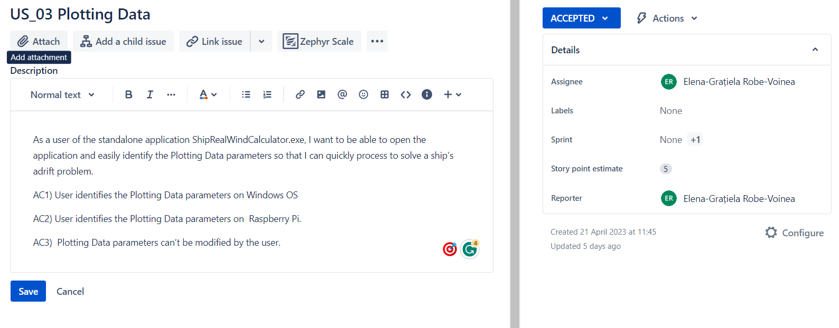
Jira Agile Board
2 sprint-uri- 3US/sprint
SHP-Sprint 1: US_1; US_2; US_3.
SHP-Sprint2: US_4; US_5; US_6
fiecare US contine 3 criterii de acceptanță
Fig. 1 –exemplu US Jira

Slide 10
Test Case-Test Runs - TestCaseLab
Pentru fiecare AC s-a realizat un TC
Fiecare TC a avut un Test Run= 19 TC->19TR
Remarca : Pentru US_4 = 4 TC->4 TR

Slide 11
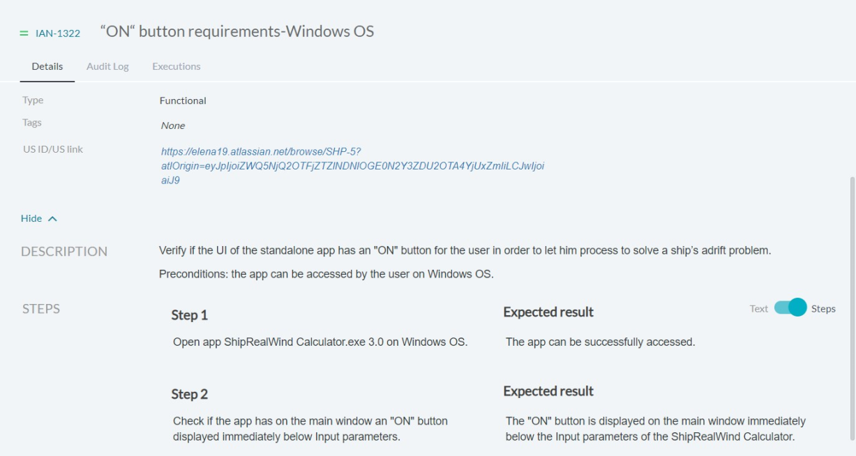
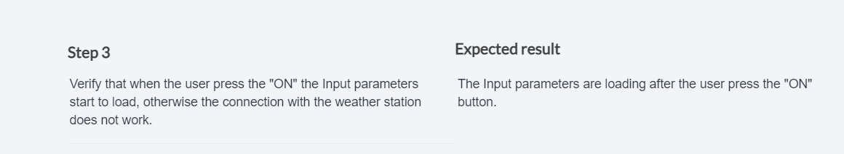
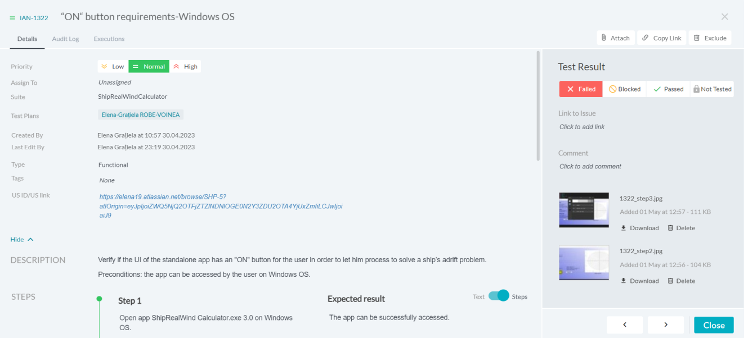
TC vs TR

Slide 12
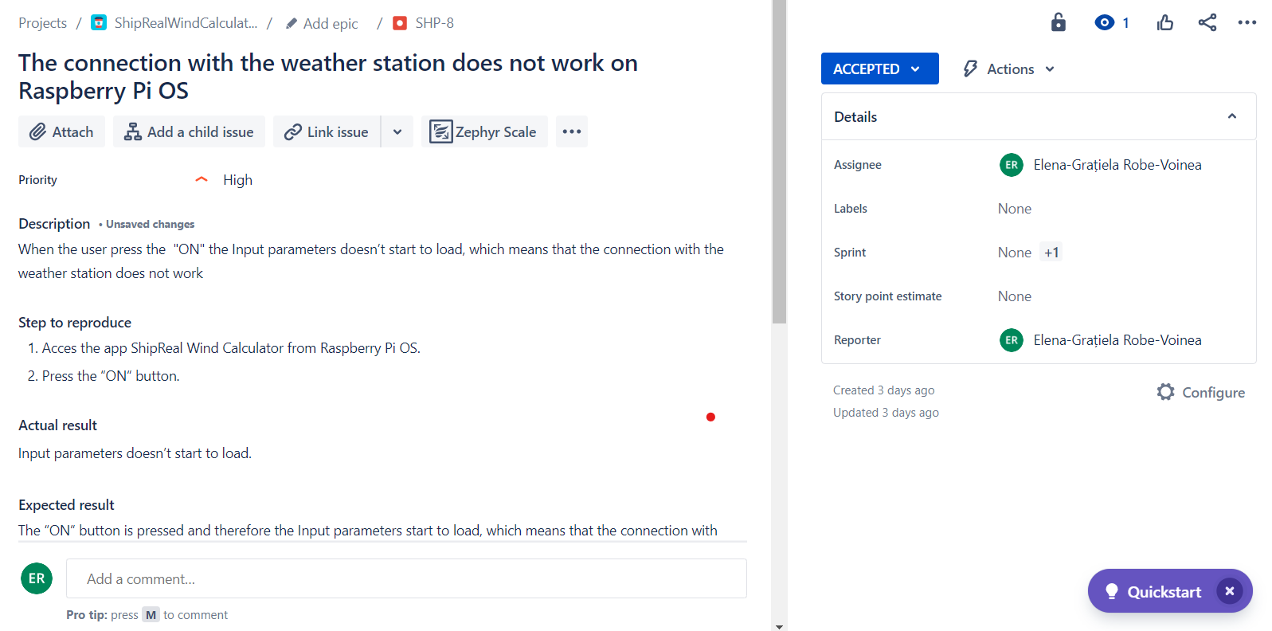
Bug/Defect report
Au fost identificate in urma executiei TC urilor 3 bug-uri

Slide 13
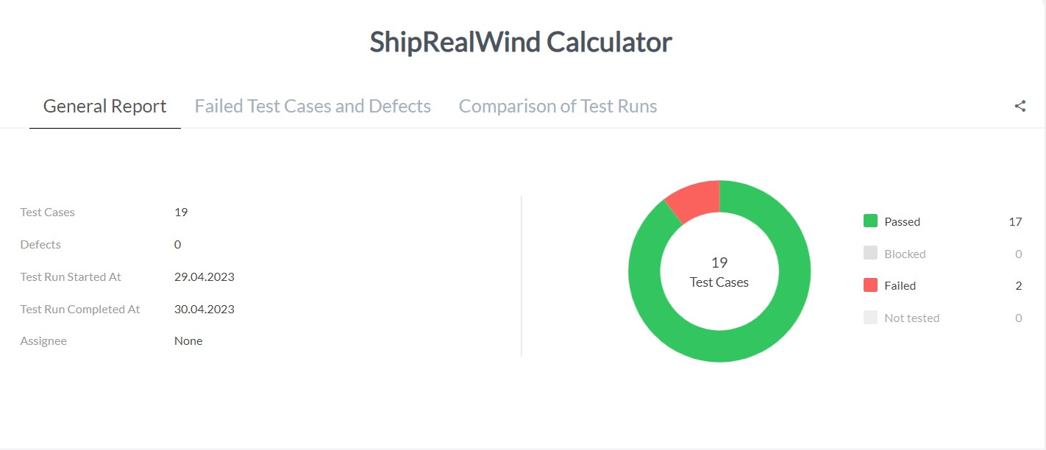

Concluzii- Matrix

Slide 14
VĂ MULȚUMESC !

